Slide 1
DEPENDENCIES IN TRANSBOUNDARY WATER MANAGEMENT IN GREECE IN THE FACE OF CLIMATE CHANGE
38th IAHR World Congress September 1-6, 2019 Panama City, Panama
E. KOLOKYTHA, Assoc .Professor
Dr. CH.SKOULIKARIS, UNESCO Chair INWEB
ARISTOTLE UNIVERSITY OF THESSALONIKI

Slide 2
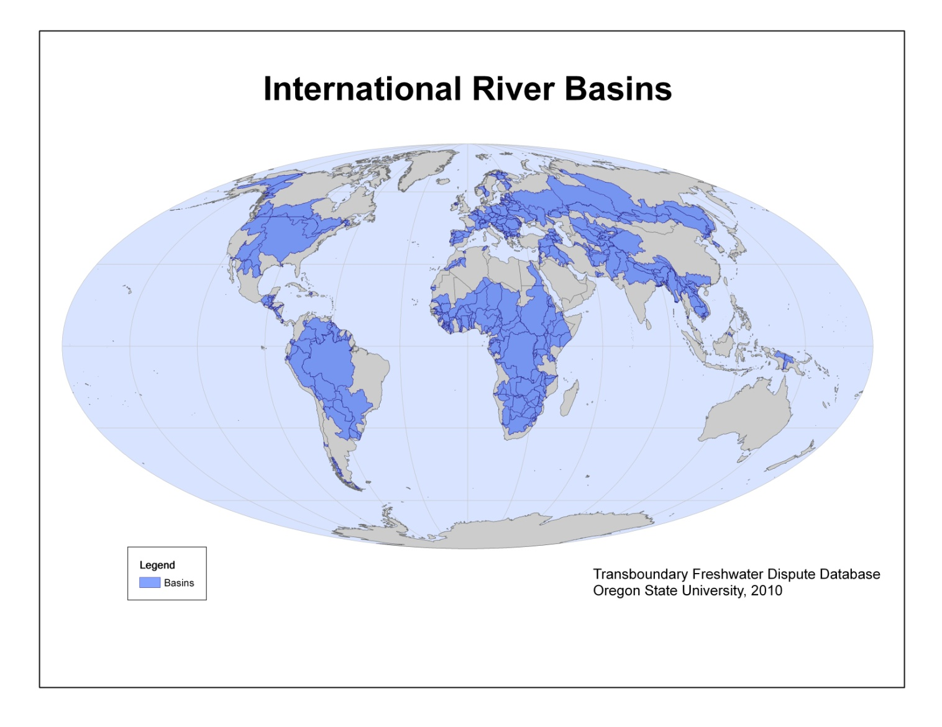
Transboundary River Basins
275 transboundary river basins
300 transboundary aquifer systems
40% of the world’s population
75% of all countries
International cooperation
Effective water diplomacy
Effective institutional legal framework
International Legislation
Notes:
Nowadays over 40 percent of the world’s population (275 transboundary river basins) resides within internationally shared river basins. Over 75 percent of all countries, 145 in total, have within their boundaries shared river basins. Globally, about 2 billion people depend on groundwater, which includes well over 300 transboundary aquifer systems.
International cooperation is a critical and important issue for discussion in order to prevent conflict and alleviate major differences.
Administrative and physical boundaries rarely match. Effective water dilpomacy, in the sense of building and facilitating the convergence of technical expertise,information and dialogue with local and international politics.
Legal regimes , treaties, billateral agreement are espouse mechanisms for cooperation.

Slide 3
The Competition for Water
Use vs. Use
Present vs. Future
Region vs. Region
Quantity vs. Quality
Water vs. Other Natural Resources
Water vs. Other Social Priorities

Slide 4
Potential Water Conflicts Arise:
Out of scarcity (permanent and temporary)
Out of differences of goals and objectives
Out of complex social and historical factors (such as pre-existing antagonisms)
Out of misunderstandings or ignorance
Out of skewed power between localities, regions, or nations
Out of significant data gaps or question of validity and reliability
Out of particular hydropolitical issues at stake (e.g. dam construction)

Slide 5
International cooperation
Challenges
Opportunities
Increasing benefits
“to the river”
THE ECOLOGICAL RIVER
Healthy water system: improvement of water quality, flow characteristics, biodiversity
Limited water reserves, degraded ecosystems, quality issues .
Increasing benefits
“from the river”
THE ECONOMICAL RIVER
Not optimal use of water for the different activities
Joint water planning
Effective management, better water allocation, flood management, development
Decreasing the cost
Because of the river
THE POLITICAL RIVER
International cooperation, peace, security.
Minimize the risk of war
Conflicts in regional / national / international level / political tension
Increasing benefits
“beyond the river”
THE CATALYTIC RIVER
Fragmented management / inefficient administrative schemes
Integrated planning, development of joint projects, contributory, benefit sharing
Sadoff et al. 2002
Notes:
Ο «οικολογικός» ποταμός Δούναβης,(16 εταίροι) Βαλτική, Ρήνος (8 εταίροι)
Ο «οικονομικός» ποταμός , παραγωγή, αποτελεσματική διαχείριση, Ισπανία αύξηση διαθεσιμότητας νερού
Ο «πολιτικός» ποταμός, Νείλος,(10 εταίροι) Ευφράτης
Ο «καταλυτικός» ποταμός, ανταποδοτικά οφέλη, έμμεσα οικονομικός

Slide 6
Transboundary water resources management
Difficulties that arise in their management and governance can be due to the lack of
political inclination for cooperation
communication channels and understanding among decision makers, scientists, water professionals, stakeholders, and
effective exchange mechanisms of data and information
Data exchange is considered a necessary step and precondition for data consolidation, joint modelling and monitoring protocols, which thereafter could lead to integrated ecosystem governance
Notes:
When dealing with transboundary water resources management (TWRM), the augmented

Slide 7

The Water Convention (1996)
Worldwide Initiatives for transboundary water resources management
The United Nations Economic Commission for Europe (UNECE) Convention on the Protection and Use of Transboundary Watercourses and International Lakes
90 bilateral and basin agreements and arrangements for transboundary water cooperation have entered into force in the pan-European region.
The Convention has offered a neutral platform for dialogue, integrating
countries facing diverse challenges regarding water resources management.
Notes:
The Convention has strengthened water governance
and transboundary and regional cooperation throughout the 25 years of its existence.

Slide 8
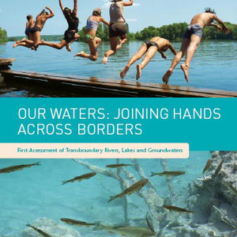
1st UNECE REPORT (2007)
A comprehensive analysis of the pressure factors, the quantity and quality status, as well as responses and future trends of the transboundary waters.
It covers 140 transboundary rivers and 30 transboundary lakes in the European and Asian parts of the region, as well as 70 transboundary aquifers located in South-Eastern Europe, Caucasus and Central Asia.

Slide 9
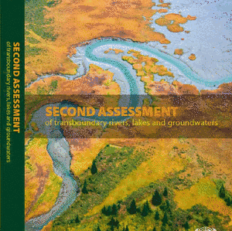
The 2nd UNECE REPORT (2011)
Issues related with climate change adaptation policies and measures, ecological and biodiversity issues, information about the legal, institutional and socio-economic status of the riparian countries are being emphasized.

Slide 10
Worldwide Initiatives for transboundary water resources management
UNESCO-ISARM: Internationally Shared Aquifer Resource Management (ISARM) programme aimed at improving the understanding of scientific, socio-economic, legal, institutional, and environmental issues related to the management of transboundary aquifers (TBAs).
ICZM: The Integrated Coastal Zone Management protocol that was ratified under the Barcelona Convention, i.e. the Convention for the Protection of the Mediterranean Sea against Pollution, is an international initiative for the efficient management of the environment. Among other objectives, ICZM aims to ensure the sustainable use of natural resources, particularly with regard to water use.
TWAP: The aim of the Transboundary Waters Assessment Programme can be aggregated to knowledge exchange, identification and classification of water bodies at risk, and increased awareness of the importance and state of transboundary waters, with the foreseen results to be used as a compass by all type of water related stakeholders.

Slide 11

Worldwide Initiatives for transboundary water resources management
WFD: The Water Framework Directive established an important framework for water-related policy development and implementation solving the problem of scale, boundary and geographical planning. (2000)
River Basin Management Plan (RBMP), a strategic report where measures for achieving the WFD’s aims are proposed, based on the designated pressures, impacts and status of the water bodies at River Basin District (RBD) scale.
RBMPs integrates among others, the point and non-point source pollution, hydromorphological pressures, heavily modified and artificial water bodies, agricultural pressures, surface and ground water monitoring data, water demands and water use, water volumes and water quality.
Notes:
The information in the RBMPs integrates among others, the point and non-point source pollution, hydromorphological pressures, heavily modified and artificial water bodies, agricultural pressures, surface and ground water monitoring data, water demands and water use, water volumes and water quality.

Slide 12
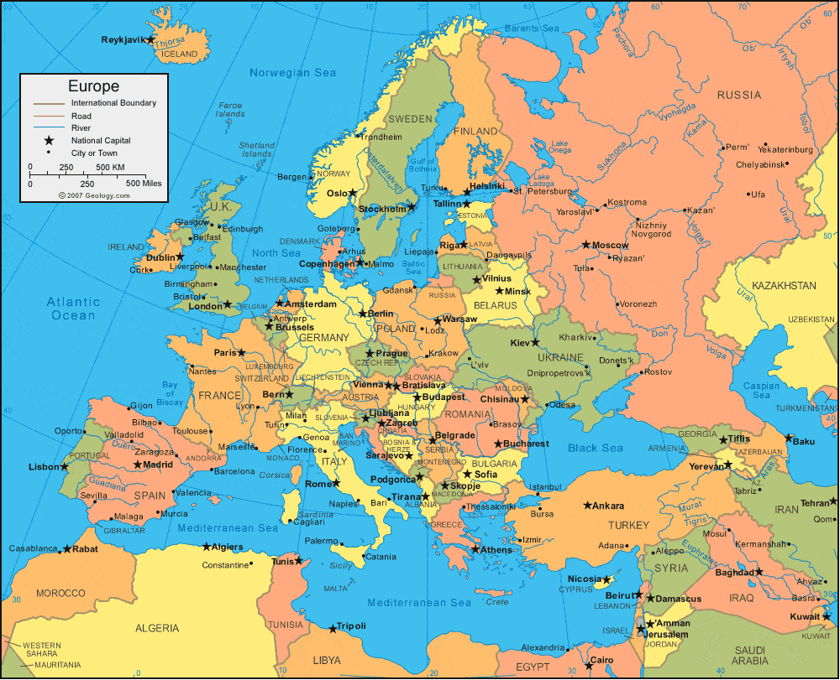
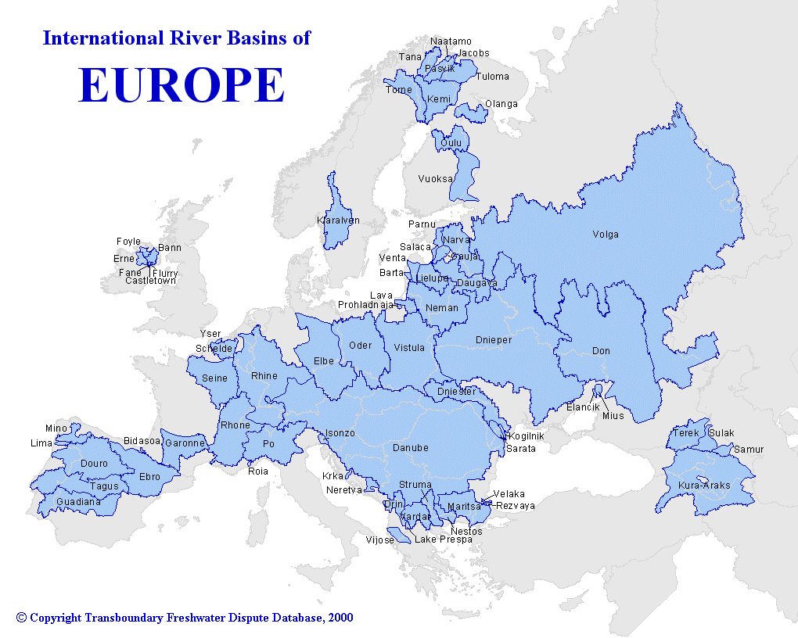

Slide 13
EUROPE- GREECE
25% of its water resources coming from neighbour countries

Slide 14
EU-GREECE
At the European continent scale, the WFD and the Water Convention are the two main frameworks that support transboundary water management and cooperation.
Assessing the progress that has been conducted in the management of the transboundary rivers of Greece (EU country) during the last decades.
Notes:
The coupling of the aforementioned legislations is a great asset for the region in terms

Slide 15
TWM-GREECE
Starting from East to West, Greece receives the waters of four international rivers:
Maritsa/Evros/Meric River (shared with Bulgaria and Turkey),
Mesta/Nestos (shared with Bulgaria),
Struma/Strymonas (shared with Bulgaria North Macedonia and Serbia),
Vardar Axios Rivers (shared with North Macedonia, Kosovo and Serbia).
Only transboundary Vjosa/Aoos River has its headwaters in Greece which discharges in the Adriatic Sea (shared with Albania).

Slide 16
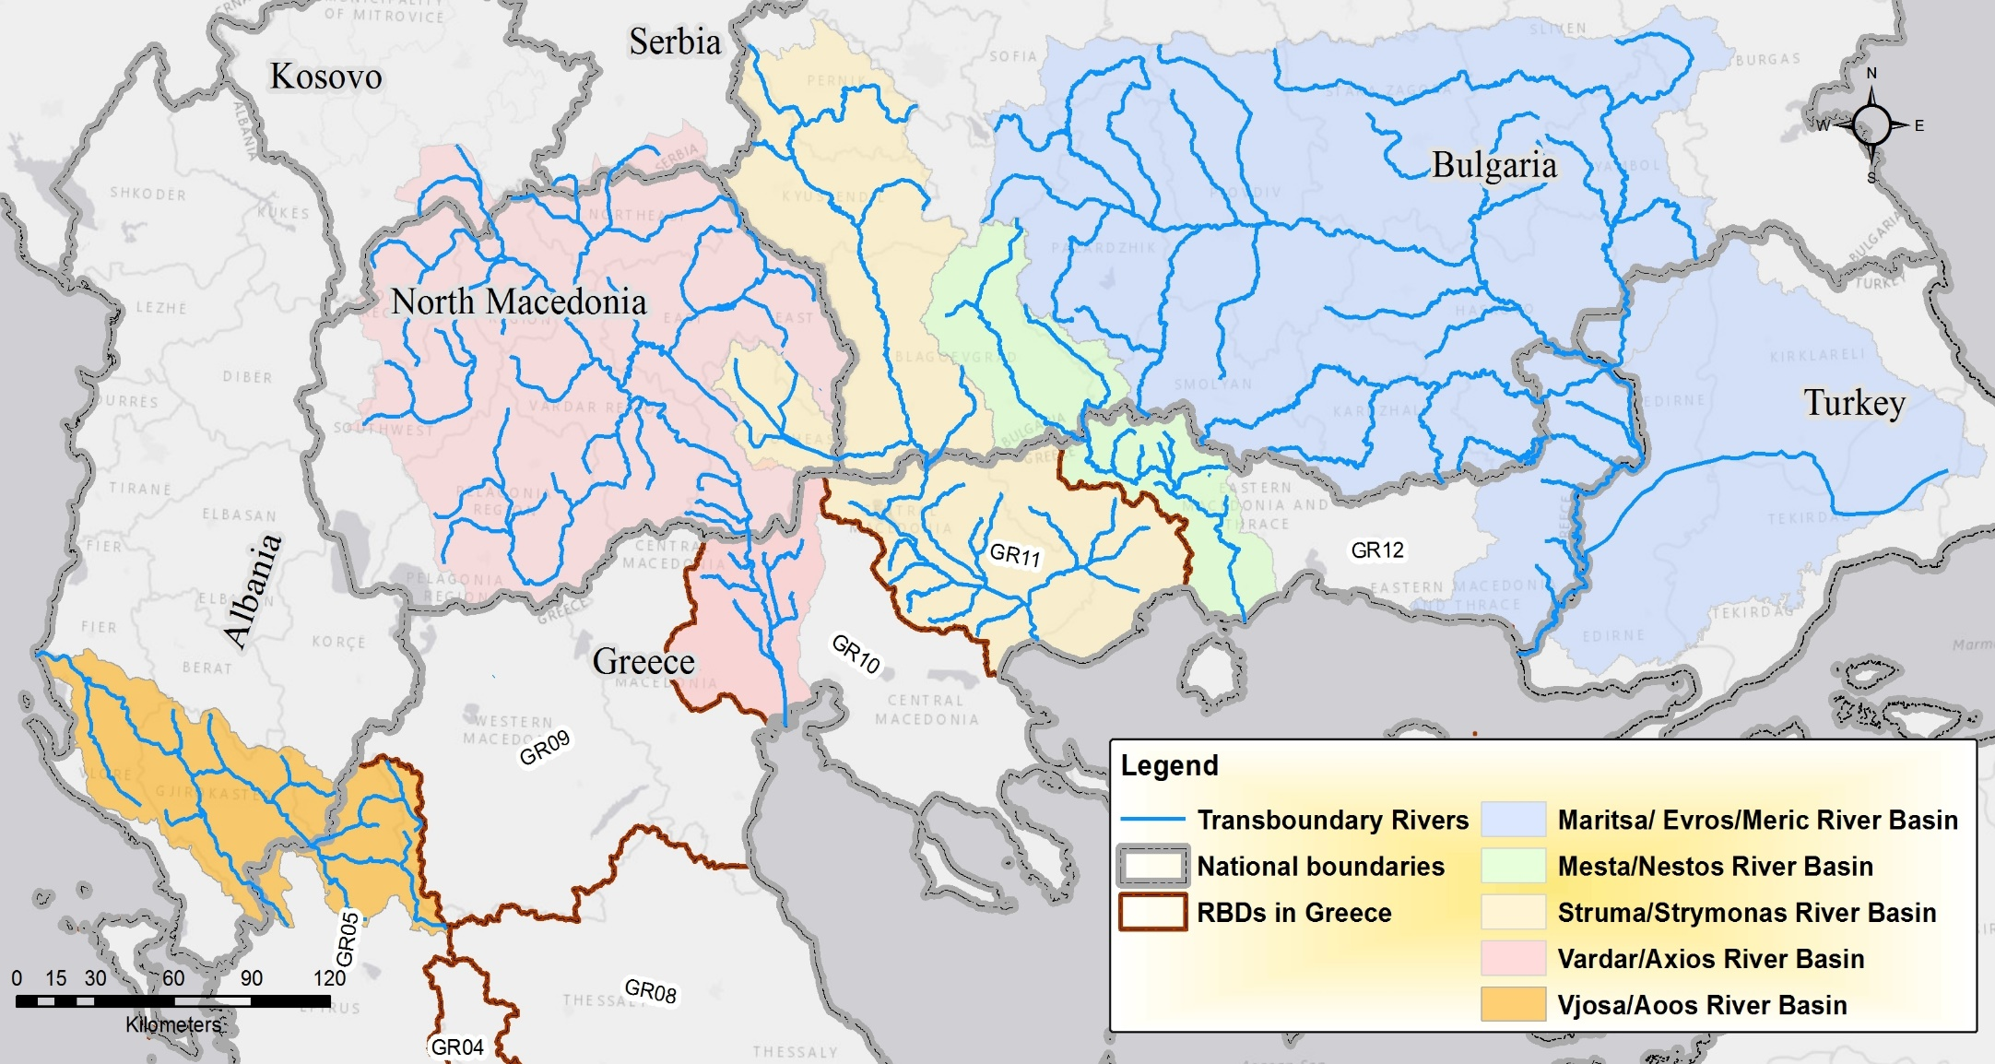
TWM-GREECE

Slide 17
TRANSBOUNBARY BASINS IN GREECE
River basin | Countries | Area in the country (km²) | Country’s share (%) | Mean elevation (m) | River length (km) | Annual precipitation (mm) | Mean Annual discharges (×10⁶m³)
Maritsa/Evros/ Meriç | Bulgaria | 35,230 | 66 | 579 | 310 | 840 | 10,895
 | Greece | 3,685 | 7 | 175 | 208 | 700 | 6,950
 | Turkey | 14,560 | 27 | 600 | 283* | 600 | 8,330
Mesta/Nestos | Bulgaria | 2,785 | 49.9 | 1225 | 125 | 810 | 958
 | Greece | 2,834 | 51.1 | 606 | 130 | 675 | 687
Struma/Strymonas | Bulgaria | 8,545 | 46.6 | 900 | 290 | 900 | 2,160
 | Greece | 7,282 | 39.7 | 430 | 110 | 675 | 1,514
 | North Macedonia | 1,648 | 9.0 | 863 | 81 | 688 | 50.1
Vardar/Axios | North Macedonia | 19,737 | 88.7 | 1124 | 302 | 707 | 3,385
 | Greece | 2,513 | 11.3 | 180 | 87 | 450 | 800
Vjosa/Aoos | Albania | 4,365 | 67.0 | 800 | 190 | 1300 | 808
 | Greece | 2,154 | 33.0 | 885 | 70 | 2000 | 1,617
Notes:
Starting from East to West, Greece shares i) with Bulgaria and Turkey the Maritsa/Evros/Meric River Basin, ii) with Bulgaria the Mesta/Nestos River Basin, iii) with Bulgaria, North Macedonia and Serbia (the latter has a very small portion of the basin) the Struma/Strymonas River Basin, iv) with North Macedonia, Kosovo and Serbia (the two latter countries possess a negligible portion of the basin,) the Vardar/Axios River Basin, and v) with Albania the Vjosa/Aoos River Basin.

Slide 18
MAJOR PROBLEMS
  Conflicting issues on riparian water management
  Climate change implications
  Dependencies on legal framework
  Deficiencies on political issues

Slide 19
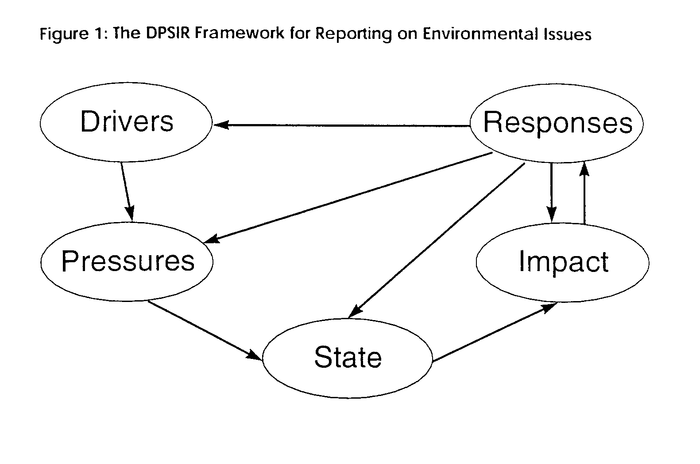
Analyze and evaluate the socio-economic drivers, the environmental pressures,
and the state of the watershed by giving policy response options
for the management of the river basin.
Notes:
The DPSIR framework is used to analyze and evaluate the socio-economic drivers, the environmental pressures, and the state of the watershed by giving policy response options with emphasis to the absence of a bilateral agreement between the two countries for the management of the river basin.

Slide 20
DPSIR methodology
The DPSIR methodology
Describe the various cause-effect relationships that can be developed by the interdependency between
drivers and pressures of the economy which define
the state of the environment and the main impact in it and
form the response of the system in the sense of policies applied to tackle with the situation.
Notes:
Driving forces lead to human activities such as transportation or food production, i.e. result in meeting a need. These human activities exert 'pressures' on the environment, as a result of production or consumption processes, which can be divided into three main types: (i) excessive use of environmental resources, (ii) changes in land use, and (iii) emissions (of chemicals, waste, radiation, noise) to air, water and soil.

Slide 21
Identified pressures on downstream waters
River basin | Pressures denoted in Water Convention | Pressures in the RBMPs
Maritsa/ Evros/Meric | Polluted waters from the Turkey’s tributaries are drained in the river. The operation of large hydropower plants in Bulgaria results on i) reduced inflows during the summer period, ii) increased inflows that frequently cause flooding phenomena during the spring. | Regarding water quality, similar results are reported in the corresponding RBMP.
Mesta/ Nestos | Reduced inflows affecting irrigated agriculture and hydropower production Also the delta ecosystem | Inflows at the bilateral agreement of 1995: 0.435x10⁹ m³ per year. Water Convention data of 2011: 0.278x10⁹ m³ per year. RBMP data of 2018: 0.142x10⁹ m³ per year.
Struma/ Strymonas | Lack of waste water treatment plants as well as the existence of illegal dumpsites for solid waste, affects the water quality | Studied and mentioned in the Greek RBMP.
Vardar/ Axios | Polluted waters due to lack of waste water treatment plants and of illegal dumpsites. | Mentioned in the Greek RBMP.
Vjosa/Aoos | Aoos Hydroelectric Dam is stated as the sole mankind pressure in the upstream part. | No specific problem mentioned in the Greek RBMP.

Slide 22
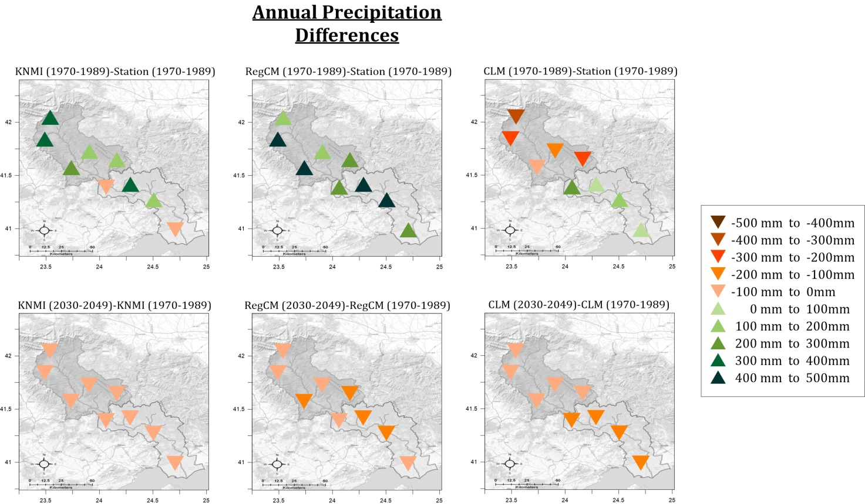
Climate change implications
Mesta/Nestos basin
Water convention: The last 20 years, the attributed to the climate change decrease of precipitations is of about 30%.
The outputs of 3 Regional Climate Models (RCMs), KNMI, RegCM3, CLM demonstrated a decrease of the future precipitations varying from 50 mm to 150 mm compared to the historic period of 1970 to 1989 (800mm) (5-15% decrease).
Fig. Annual precipitation differences (model – observations) during the reference period (upper row). Future annual precipitation changes (future – reference period) for the grid points in the domain of study (lower row).

Slide 23
Climate change implications
Mesta/Nestos basin
Runoff: Based on the CLM regional climate model, a decrease of 14.2% and 23.4% of the average inflows volumes till 2075, for the climate change emission scenarios B1 and A1B respectively is projected.
Fig. Water inflows from Bulgaria to Greece for the Ref and A1B climate scenarios. 29% inflow from Bulgaria refers to the bilateral agreement between the two countries
The agreement’s condition of 29% may not be fullfilled

Slide 24
Climate change implications to hydropower production
Mesta/Nestos basin
Power production: The feasibility study under climate change conditions of a new hydropower project showed that for the period of 2037 to 2046, the averaged produced energy will be almost 2.0 GWh, while the average monthly energy production under normal conditions would be between 3.6 GWh to 4.3 GWh.
Fig. Fluctuations of stocked water in a reservoir (blue curve) and correlation to the produced energy (red curve) for the time period 2021-2050 under climate change conditions.

Slide 25
Climate change implications in the different
sectors
Struma/Strymon basin
Based on the ALADIN model projections for the A1B scenario, the runoff at the Sedelska River (main tributary of Struma River) mouth is estimated about 15-16 % and 21% lower for the future periods 2021-2050 and 2071-2100 respectively, in comparison to the period 1961-1990 (Niagolov et al. 2017).
Doulgeris et al. (2016) demonstrate that climate change will affect the stocked water volumes availability in an artificial reservoir that is used for the irrigation of the plain. The current average water level in the lake is 32.6 m and the surface area is 55.4 km², while for the climate scenarios and future periods of A1B/2070–2100 and A2/2070–2100, the average water level is reduced to 31.9, and 31.8 m respectively, and the lake’s surface is reduced to 48.9, and 47.7 km² respectively.

Slide 26
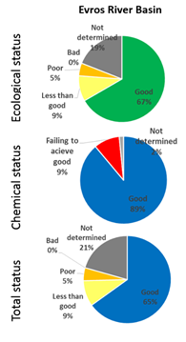
Climate change implications
Maritsa/ Evros/Meric
In the Maritsa/Evros/Meric basin, and in particular in the Bulgarian part of the watershed a significant number of big dams (>15) controls the 37.5% of the runoff.
Currently, Bulgaria and Turkey have developed an operational river basin flood forecasting and early warning system for the Tundja River Basin, also an important tributary of the Maritsa/Evros/Meric basin. Thus, Greece should take advantage of the existing facilities.
The further degradation of the Evros River water quality in case of climate change is also very likely to be happen in case of no coordinated and cooperative management plans.

Slide 27
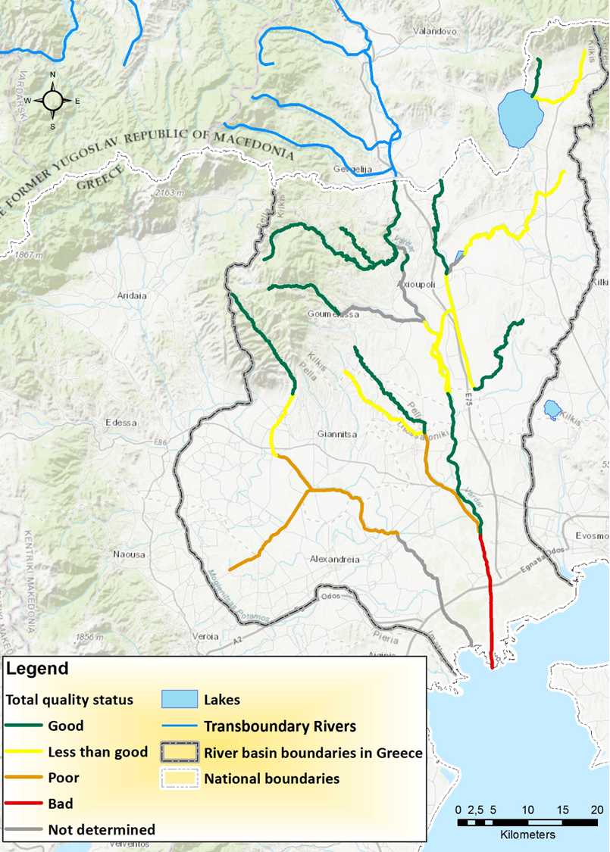
Climate change implications
Vardar/Axios
Negative impacts on the already degraded water quality mainly due to decreased streamflows and thus limited water volumes for dispersion and diffusion of the pollutants.
Higher temperatures will reduce the dissolved oxygen content in water bodies.
The RBMP in Greece finds the water that enters Greece is of good quality. Due to the operation of a WWTP in the N.Macedonia part at the borders and similar projects, mainly funded by EU funds
(EuropeAid program)

Slide 28
  Dependencies on legal framework
Transboundary cooperation on a regular basis is not observed.
no common legislative framework for cooperation. EU-non EU countries
the lack of data exchange mechanism
the unreliability of the exchanged data
lack of political will to proceed to bilateral agreements
Notes:
Three of the riparian countries, namely Turkey, North Macedonia and Albania, which share a water body with Greece are not members of EU

Slide 29
  Deficiencies on political issues
Historically poor relations between Turkey and Greece
continuous problems regarding the division of maritime zones in the Eastern Mediterranean
the Exclusive Economic Zone disputes
cooperation between the two countries is less than satisfactory.
Greece and North Macedonia had political disputes on
the constitutional name of the latter, an issue that had raised increased tension between the two countries.
The Greek veto to the accession of exFYROM’s candidacy to EU and NATO complicated the situation over a possible consultation for “low-politics” issues
No diplomatic discussion were made for any kind.

Slide 30
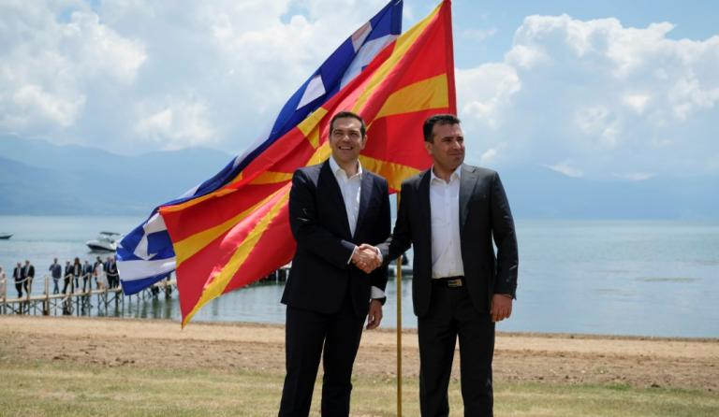
Nominated for Nobel prize for peace 2019
The ratification of the “Prespa Agreement” in Feb. 2019 creates new “political” balances and provides the ground for the resolution of water management problems and the potentiality for bilateral cooperation.

Slide 31

How and through what kind of processes
water in transboundary river basins
may unify rather than divide sharing nations?
How stakeholders in international water
catchments may increase their benefits
without causing losses to others?

Slide 32
A step forward
Develop an approach towards the equitable allocation not of the water but the benefits deriving from it.
From a dialogue mostly focused on the rights a country feels it is entitled, to the needs what is actually required to achieve its goals.
Effective transboundary cooperation demands “parts” that want to “work” with their opponents, show good faith, introduce solutions and facilitate negotiations.
from confrontation to cooperation
from monologue to dialogue
from compromise to consensus

Slide 33
Conclusions
Implementation of the WFD and FD between EU countries
Political problems intensify weak cooperation
Climate change implications intensify also water scarcity problems and water pollution at river basins
Administrative issues, gaps in data and stakeholder participation are also considered.

Slide 34
Transboundary water management, even though refers to the 25% of Greece’s water reserves, has not gained the particular importance in the priority agenda of the country.
Notes:
This is deducted by the absence of signed agreement between the riparian countries or at least enhancing in accordance with WFD the only existed agreement, in Mesta/Nestos river basin in effect.

Slide 35
Issues for Transnational Consultation
Implementation of the European Directive 2000/60/EC & corresponding adjustments
Joint agreements
Developing new & improving existing joint monitoring networks of environmental parameters
Coordination to achieve the objectives of the WFDirective in the next program period ( 2021-2027)
Joint River Basin management plan in program period 2021 - 2027
Crisis Management: Joint action plan for emergency situations (e.g. industrial accidents, extreme droughts, floods)
Promoting of common development philosophy for the entire region
Consultation on high priority projects . Encourage the consideration of water and environment related trade off and synergies in developing renewable energy.
Notes:
The water management issues between Greece and FYROM are tightly related to their political and economic relationships. Transboundary water management needs to be faced from a multi-resource perspective. Which means to develop an approach towards the equitable allocation not of the water but the benefits deriving from it.

Slide 36
Steps forward for effective transboundary river basin cooperation
Complex ecosystemic and environmental problems
Uncertainty and high vulnerability of the system
Climate change and the end of stationarity
Enpower -Political will
Envisioning
Enactment
Notes:
As patterns of change are complex, uncertainties are large and the knowledge base changes rapidly environmental concerns and other policy issues must be adequately established and effective monitoring should be applied.

Slide 37
“hydro-political interactions”
QUESTIONS…

